Slide 1
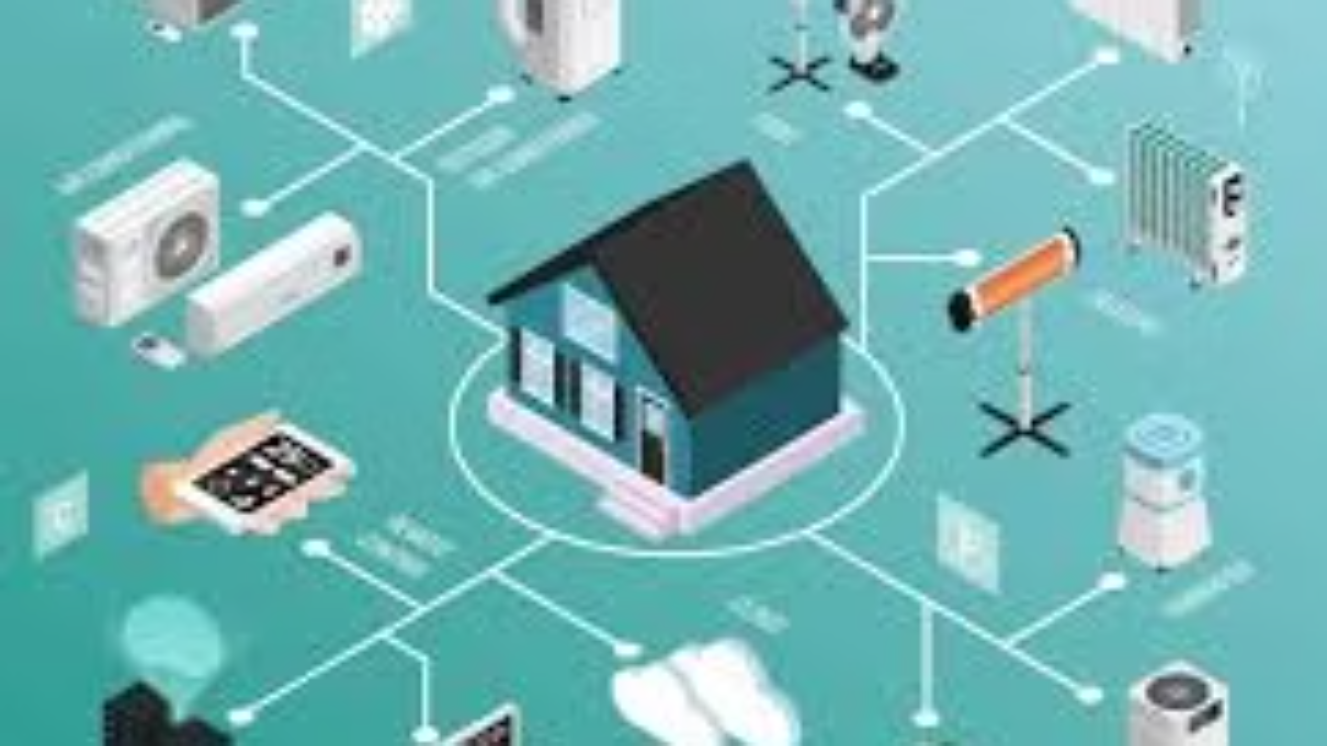

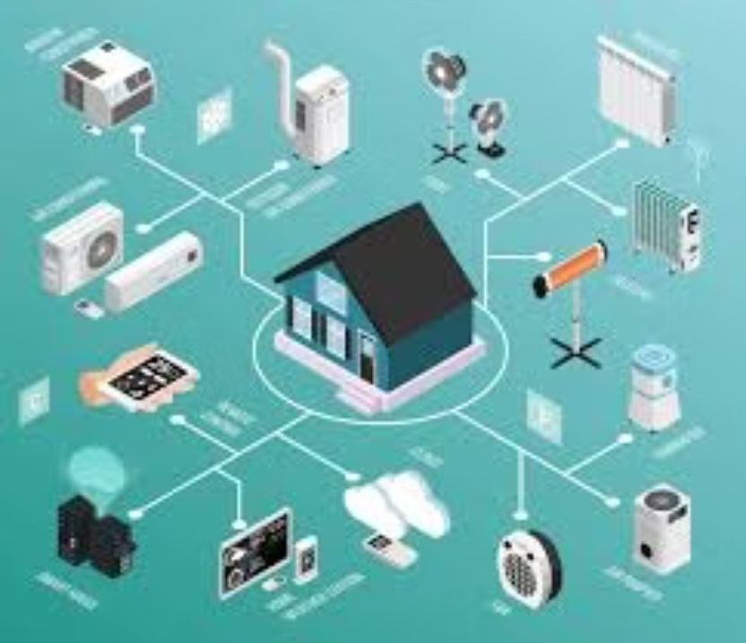
Smart Home Energy Management System
Domain: Smart Hostel & IOT Automation
Presented by
Fahim Shaik
Under the Guidance of
Ms. T. Premalatha

Slide 2
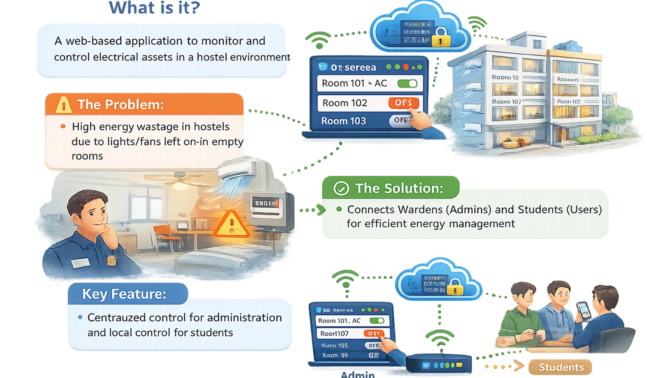

Introduction

Slide 3

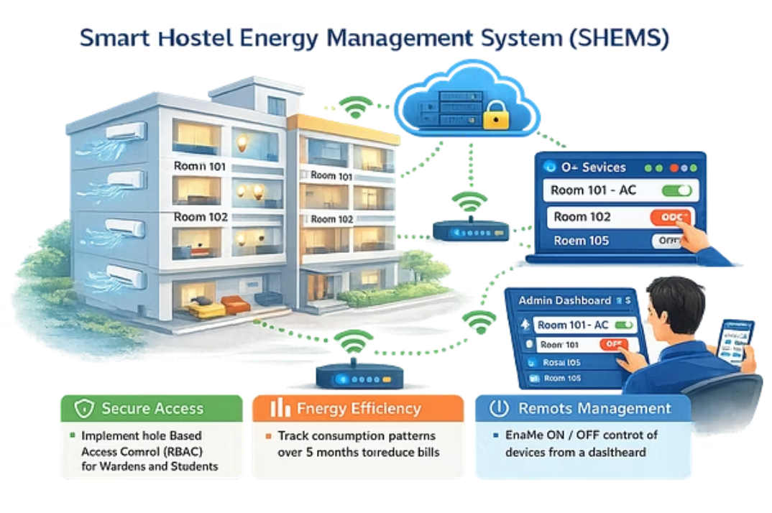
Objectives
Secure Access: Implement Role-Based Access Control (RBAC) for wardens and students.
Energy Efficiency: Monitor energy usage over six months to reduce costs.
Remote Management: Enable centralized ON/OFF control via dashboard.
Goal: Digitize hostel operations and promote energy conservation.

Slide 4





Technology Stack & Development Environment
Backend
Frontend
Database
Java • Spring Boot • Spring Security • Spring Scheduler • Hibernate/JPA
Thymeleaf • HTML • CSS • JavaScript
MySQL
Analytics & Reports
Tools
Dashboard Charts • PDF Reports
Eclipse • Maven • Git • GitHub
Full Stack Java Web Application

Slide 5




CORE CONCEPT 1: Authentication & RBAC
Security
Role-Based Access
Technology
Secure login using Email and Password authentication.
Admin (Warden):
Access to all rooms
Global settings and user management
Built using Spring Security for authentication and role validation.
Student (User):
Restricted access
Control devices only in assigned room

Slide 6
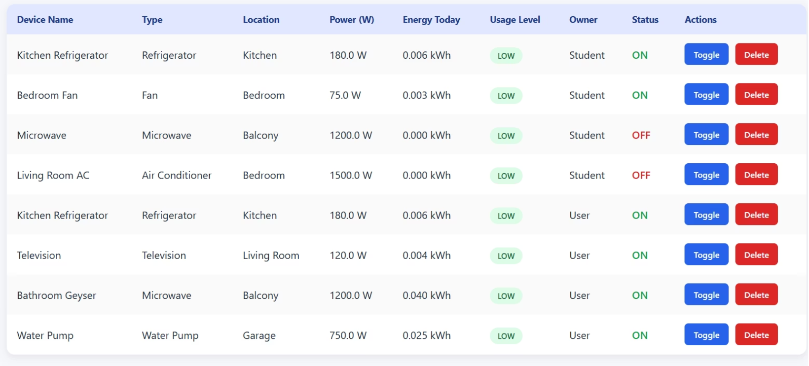
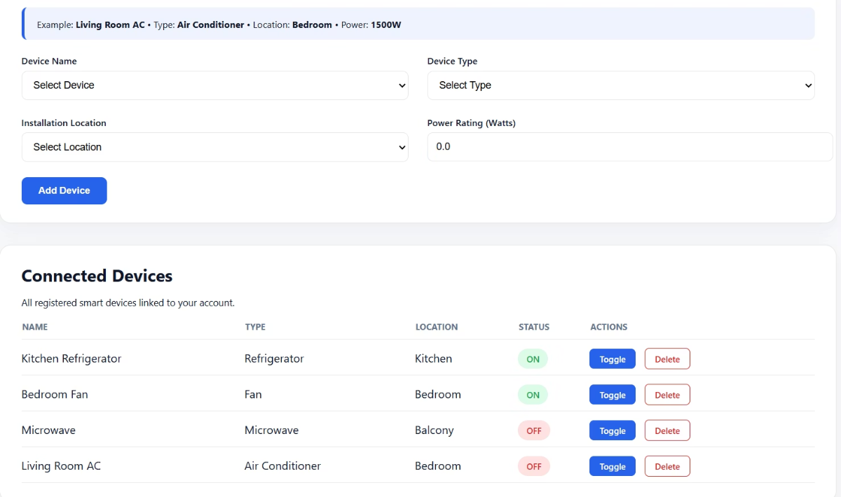

CORE CONCEPT 2: Smart Device Management
Admin Capabilities
User Capabilities
View status of all devices (Active vs Inactive)
Global ON/OFF control for emergencies
View and Add "My Room" devices only
Toggle devices ON/OFF remotely

Slide 7
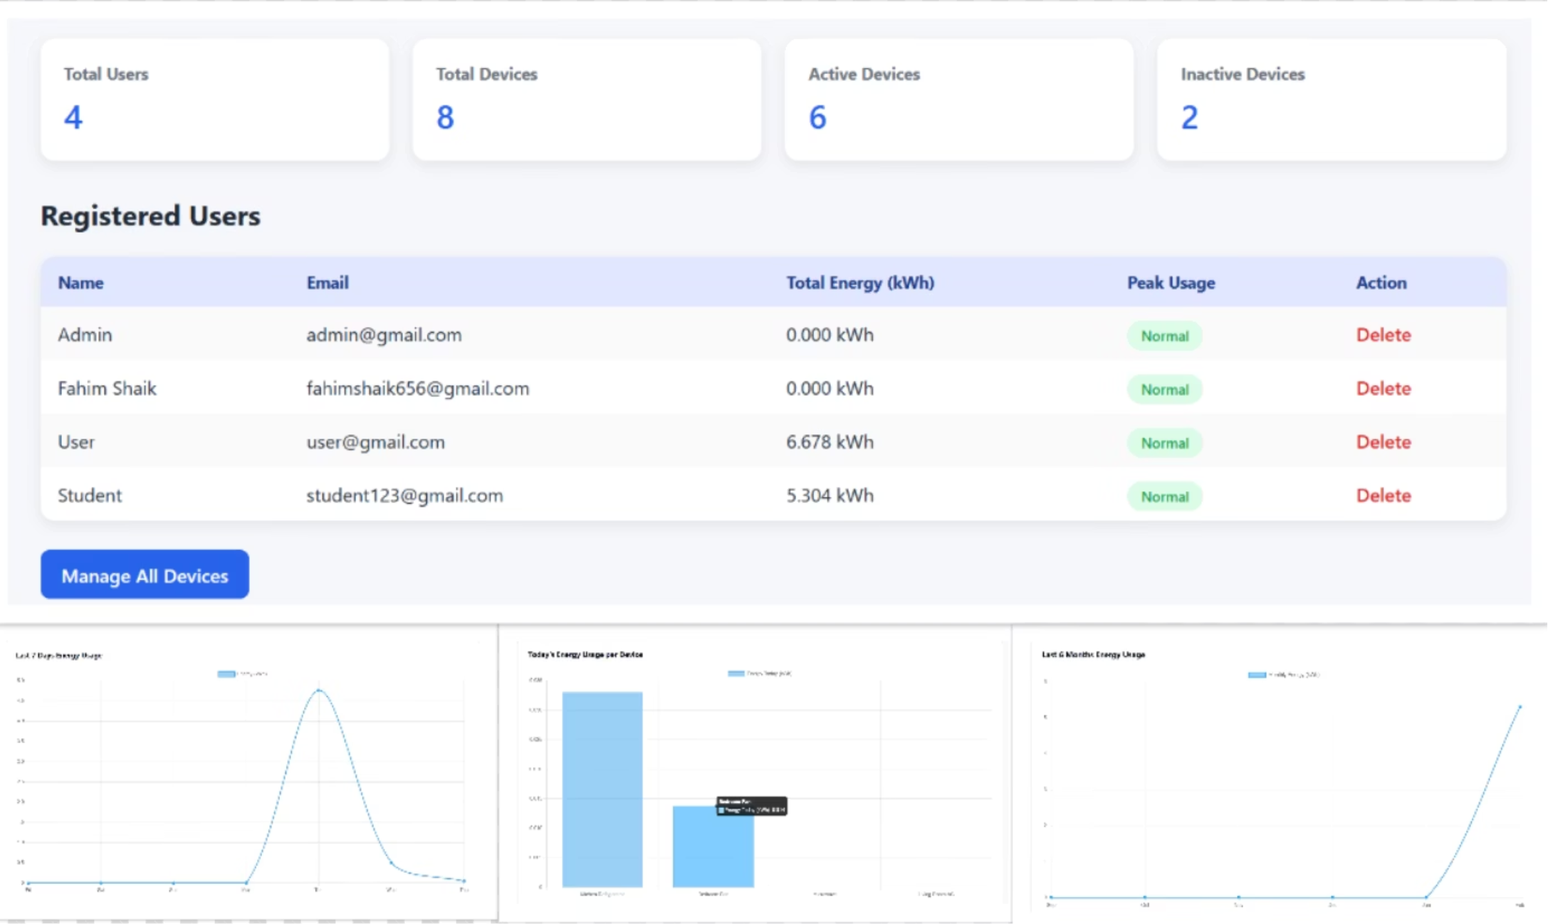
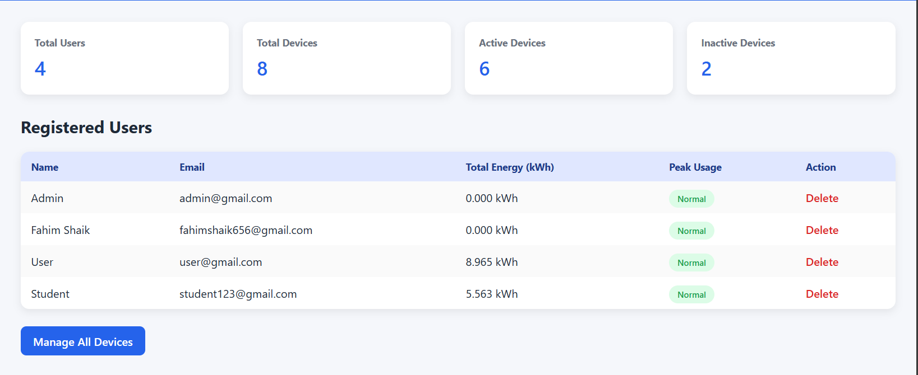

Core Concept 3: Analytics & Dashboard
6-Month Analytics
Visual graphs show energy consumption trends over the last half-year.
Consumption Reports
Identifies high-consumption areas and displays real-time energy-saving metrics.
Dashboard Insights
Shows “Total Devices in Use” and monthly estimated costs.

Slide 8
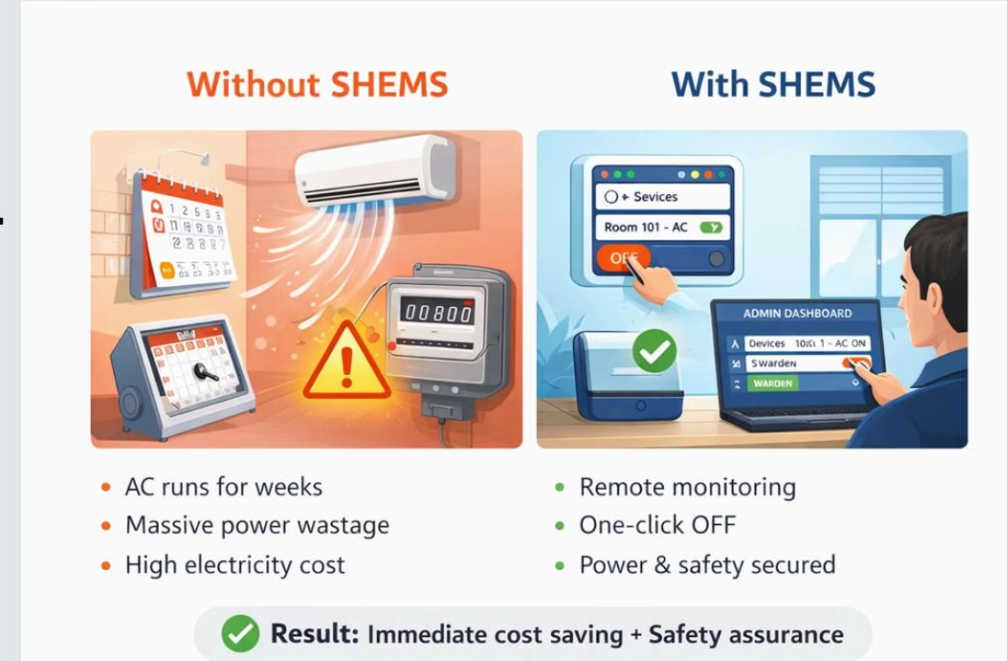

Real-Time Example
Scenario: A student goes on semester leave but forgets to turn off the room AC.
Without SHEMS: The AC runs for weeks, causing massive power wastage.
With SHEMS: The warden checks the global dashboard and sees “Room 101 AC” is ON.
The warden remotely turns it OFF from the admin panel.
Result: Immediate cost savings and improved safety.

Slide 9





Benefits
Cost Reduction
Lowers monthly hostel electricity expenses.
Granular Control
Prevents students from accessing other rooms' devices.
Convenience
Control room devices from phones or laptops.
Data-Driven Decisions
Provides insights from six months of usage history.

Slide 10






Challenges
Hardware Setup
Every switch and socket must be IoT-enabled.
Connectivity
Requires stable internet to sync device status in real time.
Data Storage
Minute-level analytics for 6 months requires database optimization.

Slide 11

Conclusion
Summary
SHEMS modernizes hostel management using secure roles and IoT control.
Impact
Empowers wardens with data and provides convenience to students.
Outcome
Creates a sustainable and energy-efficient hostel environment.

Slide 12

Thank you

